Slide 1
Week-5: The Battle of Neighborhoods
Coursera Capstone Project

Slide 2

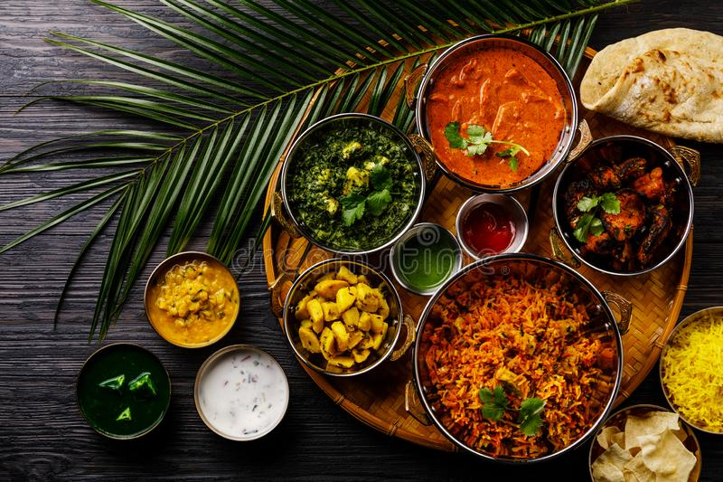
Predicting a Neighborhood in Toronto for opening a new Indian Restaurant!!!!

Slide 3
Extracting the Data
Scrapping of Toronto neighborhoods via Wikipedia
Getting Latitude and Longitude data of these neighborhoods via Geocoder package
Using Foursquare API to get venue data related to these neighborhoods

Slide 4
Analyzing the Outcome
The results from k-means clustering show that we can categorize Toronto neighborhoods into 4 clusters based on how many Indian restaurants are in each neighborhood:
Cluster 0: Neighborhoods with little or no Indian restaurants
Cluster 1: Neighborhoods with no Indian restaurants
Cluster 2: Neighborhoods with high number of Indian restaurants
Cluster 3: Neighborhoods with fewer Indian restaurants

Slide 5
Recommendation
There are no Indian Restaurant in Cluster 1, which includes neighborhood like Richmond, Adelaide, King, Parkdale, Queen's park, Forest Hill, etc. Cluster 2 and 3 have good count of Indian Restaurants, whereas Cluster 0 has some restaurants in that neighborhood.
Studying the above cluster, I would recommend the food chain restaurant to open an Indian restaurant in Cluster 1 with little to no competition.

Slide 6
THANK YOU

